Slide 1
Moving The Needle
Isha Negi, Neel Bhagwat, Sanskriti Shivhare

Slide 2
01
Introduction
Notes:
What question is the student trying to answer? Is this question clear? (14 pts)
Title slide

Slide 3
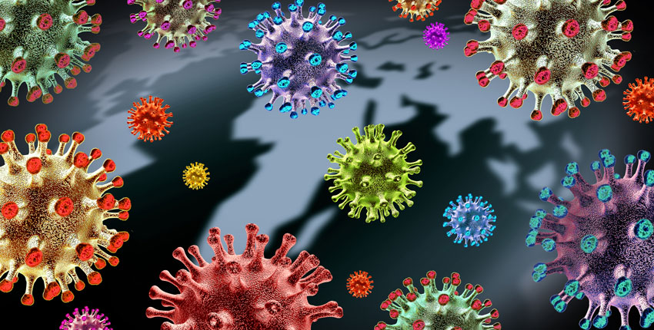

Introduction
Image Sources: Harvard Medical School & Yale University
Notes:
Define a problem of interest (+2).
Vaccine hesitancy is threatening to the general public - the US and the world: undervaccinated communities serve as breeding grounds for new COVID-19 variants that threaten to evade immunity from prior infections and vaccinations
Fighting the COVID-19 pandemic requires getting enough of the population vaccinated
Multiple studies have cited COVID-19 increased vaccine hesitancy or refusal amongst Black Americans - history of mistreatment leading to mistrust of healthcare system, Tuskegee Syphilis Study, misinformation
A 2021 study found that attitudes towards police influence vaccine hesitancy, driven by historical injustices in public health policing such as a forced-at-gunpoint smallpox vaccination campaign directed towards Middlesboro in 1898

Slide 4
Notes:
Pick a question you would like to address relevant to this problem (+2).
We are trying to find out whether attitudes towards the police cause vaccine hesitancy amongst Black Americans.

Slide 5
Notes:
BLUF: Specify what, specifically, are the constructs that you are studying (+2).
To answer this question, we studied the literature to assess the various causes of vaccine hesitancy amongst Black Americans:
Trust in the government
Attitudes towards law enforcement
Interactions with law enforcement
Trust in the healthcare system
Political activity
Perceived discrimination
Susceptibility to misinformation
Vaccine uptake
Attitudes towards vaccine mandates
Socio-economic factors
Severity of epidemics

Slide 6
Notes:
BLUF: Specify how you will measure what you are studying (+2).
ANES 2016 Survey
ANES 2020 Survey
NYC data on:
Socio-economic status (American Community Survey, US Census Bureau, 2020)
Arrest data, NYPD, May 2021 - October 2021
COVID-19 vaccine uptake from May 2021 - October 2021, NYC Department of Health
COVID-19 cases from May 2021 - October 2021, NYC Department of Health

Slide 7
Notes:
BLUF: Specify the logic relating the things that you are measuring. (+2)
Talk about quasi-study designs using non-equivalent groups, other reasons that may have caused vaccine hesitancy:
Study 1 (ANES 2020): control for other confounding variables that may have influenced vaccine uptake;
Treatment is all respondents with higher than average attitudes towards the police, control is all respondents with lower than advantage attitudes towards police the police in 2020
Study 2 (ANES 2016 vs. ANES 2020): ANES 2016 vs ANES 2020: control for the BLM protests and the COVID-19 pandemic
Treatment is all respondents with higher than average attitudes towards the police, control is all respondents with lower than average attitudes towards the police in 2016
Study 3 (NYC ZIP-level data): NYC arrest data: control for accessibility, income, education, COVID cases during Delta wave
Treatment is all residents of a ZIP code with higher than average arrests/capita, control is all respondents with lower than average arrests/capita in 2021

Slide 8
Notes:
BLUF: Specify the algorithm or technique that you will use to assess the strength of relationship between these things. (+2)
ANCOVA - control for confounding variables and compare two groups in designs

Slide 9
Notes:
BLUF: Tell us why it would matter if that relationship existed. (+2)
Improve upon prior literature by controlling for other causes of vaccine hesitancy
- Inform criminal justice experts about the importance of police accountability and the implications of police brutality
Inform public health experts in communicating vaccines to mitigate the COVID-19 pandemic and prepare for future pandemics
Advocate for new policies in police accountability

Slide 10
02
Sampling
Notes:
Where will the student get their data? Does this make sense, given their question? (15 pts)
Title slide

Slide 11
Notes:
What is your unit of analysis? Why? (+2)
Individual African American respondents who took the American National Election Survey in 2020 and 2016 - We Would like to know the attitudes and opinions on key issues related to vaccine hesitancy of individual Black Americans, surveying Black individuals would serve that purpose
ZIP codes - why?
We are studying ZIP codes as we would like to see how interactions with the police in different areas may influence vaccine uptake - while we may be studying people we would be analyzing ZIP codes as a whole

Slide 12
Notes:
What is the theoretical population from which this unit will be selected? Why? (+2)
Theoretical Population: Our target population on which we are interested to generalise our findings will be the African American community across the US. Since we aim to find vaccine hesitancy in various sections of the country, Black individuals from different communities serve as part of the population of interest in our study.

Slide 13
Notes:
What is the accessible population from which this unit will be selected? Why? (+2)
Accessible Population: The scope to consider the whole african american community in the US for vaccine hesitancy is too large and, hence, difficult to sample. Respondents from the ANES surveys in 2016 and 2020 can serve as our accessible population as the study is nationally representative and contains Black respondents
NYC residents: It would be out of scope for us to get data on arrests and vaccine rates across the entire country. We would have to go through multiple public health and police departments’ websites. We selected to get data from New York City as it is the largest metropolitan area in the country and may give us the largest sample size

Slide 14
Notes:
What is the sampling frame that will you use to select your sample? Why? (+2)
Sampling Frame: The ANES survey includes all the respondents from different communities of the country. In order to maintain homogeneity in our sample, we decided to use only the responses from African Americans in ANES 2016 and 2020 surveys as our sampling frame.
Counties with at least a 30% Black population in NYC - we can’t obtain Black Americans, so we take counties with at least a 30% Black population so we can also control for other races and find out whether the relationship between police and vaccine rates is embedded in systemic racism

Slide 15
Notes:
How large will your sample be? Why? (+2)
Sample: ANES: The records which are derived from the sampling frame after data cleaning process (we want to filter out inapplicable and incomplete responses) may be reasonably representative of the target population, African American community - after cleaning we obtained a sample of 726 respondents from 2020, 164 of them who took the 2016 survey. This will be the final sample which would help derive findings related to vaccine hesitancy.
178 zip codes according to US Census Bureau

Slide 16
Notes:
What are some threats to the external validity of your sampling strategy? (+2)
Threats to external validity:
Sampling strategy: the random sampling of respondents by ANES may introduce biases toward particular locations or subpopulations, more info is needed about subpopulations in order to make stronger claims about our data; ANES should consider stratifying their sample by location, given that they have address-specific USPS data to use
The final sample size for the study is 726 - which is fairly small Our sample likely does not contain responses from various subpopulations, which compounds on the problem that we don’t know the specific subpopulations to begin with
Threats when using NYC only?
People of other races live in ZIP codes in NYC

Slide 17
Notes:
Will you use probability sampling or non-probability sampling? What specific sampling strategy will you use? Why? (+2)
Sampling strategy: The ANES survey respondents are recruited at random - every resident of the United States (including Washington DC) has equal chance of being selected - respondents randomly drawn from USPS delivery sequence data. By using this dataset, we are adopting the sampling strategy of this study employing simple random sampling (probability sampling) on our theoretical population - Black Americans are randomly selected for this study.
For the NYC study, we are employing modal instance sampling as we are gathering data about ZIP codes in the largest municipality in the country, so we are under the assumption that New York City is the “modal” city. While it is ideal to use data from multiple cities throughout the country, data from one major city is a good start.

Slide 18
Notes:
How does your sampling strategy relate to your research question? (+1)
Why are we sampling ANES data? Why does random sampling tie into who we are studying?
How does sampling strategy of NYC study tie into what we are relating?

Slide 19
Notes:
Given their datasource, what is the student trying to measure? Are they measuring what they think they’re measuring? (15 pts)
Title slide

Slide 20
Notes:
What are the key constructs in your theory? (+2)
Past literature has highlighted the following factors when discussing vaccine hesitancy amongst Black Americans:
Trust in the government - vaccine hesitancy is often driven by an overall mistrust of the government, and for Black Americans, police can be “the face of government” to them [8]
Attitudes towards law enforcement - driven by injustices in public health policing [8]
Interactions with law enforcement - driven by injustices in public health policing [8]
Trust in the healthcare system - historical injustices in the healthcare system, such as the Tuskegee Syphilis Study may influence attitudes and beliefs about vaccines [8]
Political activity - conservatives have historically been more vaccine-hesitant [8]
Perceived discrimination - past literature has studied the link between perceived discrimination and vaccine uptake [7]
Susceptibility to misinformation - link between perceived discrimination and vaccine uptake [7,8]
Vaccine uptake - a measure of a behavioral outcome we are interested in
Attitudes towards vaccine mandates - reflective upon mistrust towards the government [8]
Socio-economic factors - income, education level may influence access or beliefs about the vaccine [8]
Severity of epidemics - may influence perceived disease risk [7]

Slide 21
Notes:
What measures will you use to operationalize your constructs? Why? (+2)
Make table of constructs mapping to variables and their construct names
Trust in the government - whether people have a say in government, perceived increase in corruption
Attitudes towards law enforcement - feeling thermometers (out of 100) towards the police and other law enforcement agencies
Interactions with law enforcement - arrest rate
Trust in the healthcare system - from code
Political activity - participation in politics and elections
Perceived discrimination - from code
Susceptibility to misinformation - from code
Vaccine uptake - vaccine rate, has respondent put off healthcare or vaccines
Attitudes towards vaccine mandates - 2016, 2020
Socio-economic factors - income, education level, accessibility
Severity of epidemics - COVID case rate
Are these measures nominal, ordinal, interval, or ratio? Why? (+1)

Slide 22
Constructs and Features
Construct | Features
Political affiliation | Pays attention to politics/elections? - ordinal Party affiliation (Democrat/Republican) - interval Presidential candidate preference, 2020 - ordinal Republican presidential feeling thermometer, 2020 - interval Democratic presidential feeling thermometer, 2020 - interval Political affiliation (Liberal/Conservative) - interval
Notes:
For most features, we use an interval scale. It is important to note that most questions are on a Likert scale - respondents asked the degree of their opinions. Some questions involve a “feeling thermometer” on a scale from 0-100 to show attitudes towards a particular issue. Others involve a scale of 1-5. We care about the magnitude of respondents’ opinions on these scales when assessing our constructs, but we cannot determine an absolute zero, so interval scaling would be most fitting
Some responses only have two choices, such as preference for presidential candidate (Joe Biden vs. Donald Trump) and whether respondents have been arrested or stopped by police - these features are scaled ordinally
Are these measures nominal, ordinal, interval, or ratio? Why? (+1)

Slide 23
Constructs and Features
Construct | Features
Political affiliation
Notes:
Justify your selection of these measures in terms of their validity – what type of validity (face, content, predictive, etc.) can you demonstrate? (+2)
Content validity we found in past studies that conservatives have historically been more vaccine-hesitant [8]
How will you demonstrate the convergent and discriminant validity of your measures? (+2)
Demonstrate the validity of your measures on pilot data? (+2)
Correlation matrix of variables in the above slide to show convergent and divergent validity

Slide 24
Constructs and Features
Construct | Feature
Trust in the government | Does the federal government maintain integrity? - interval Do big interests dominate the government? - interval How much tax money does the government waste? - interval Level of corruption in government - interval Relative level of corruption in government since Trump - interval Does the federal government treat Blacks or Whites better? - interval Respondents’ voice in government - interval Does the government value peoples’ opinions? - interval
Notes:
Are these measures nominal, ordinal, interval, or ratio? Why? (+1)

Slide 25
Constructs and Features
Construct | Features
Trust in the government
Notes:
Justify your selection of these measures in terms of their validity – what type of validity (face, content, predictive, etc.) can you demonstrate? (+2)
Content validity - in the literature, we found that vaccine hesitancy can be driven by an overall mistrust of the government, and for Black Americans, police can be “the face of government” to them [8]
How will you demonstrate the convergent and discriminant validity of your measures? (+2)
Demonstrate the validity of your measures on pilot data? (+2)
Correlation matrix of variables in the above slide to show convergent and divergent validity

Slide 26
Constructs and Features
Construct | Features
Trust in the healthcare system | Feeling towards president handling COVID-19 in 2020 - interval Confidence in medical institutions - interval Confidence in the scientific community - interval World Health Organization feeling thermometer - interval Centers for Disease Control feeling thermometer - interval Scientists feeling thermometer - interval Importance of science in COVID-19 response – interval
Notes:
Are these measures nominal, ordinal, interval, or ratio? Why? (+1)

Slide 27
Constructs and Features
Construct | Features
Trust in the healthcare system
Notes:
Justify your selection of these measures in terms of their validity – what type of validity (face, content, predictive, etc.) can you demonstrate? (+2)
How will you demonstrate the convergent and discriminant validity of your measures? (+2)
Demonstrate the validity of your measures on pilot data? (+2)
Correlation matrix of variables in the above slide to show convergent and divergent validity

Slide 28
Constructs and Features
Construct | Feature
Susceptibility to misinformation | Do vaccines cause autism? - ordinal Is hydroxychloroquine an effective treatment for COVID-19? - ordinal Was SARS-CoV-2 developed in a lab? - ordinal Do the health benefits of vaccines outweigh the risks? - interval
Notes:
Are these measures nominal, ordinal, interval, or ratio? Why? (+1)

Slide 29
Constructs and Features
Construct | Features
Susceptibility to misinformation
Notes:
Justify your selection of these measures in terms of their validity – what type of validity (face, content, predictive, etc.) can you demonstrate? (+2)
How will you demonstrate the convergent and discriminant validity of your measures? (+2)
Demonstrate the validity of your measures on pilot data? (+2)
Correlation matrix of variables in the above slide to show convergent and divergent validity

Slide 30
Constructs and Features
Construct | Feature
Sentiments towards law enforcement | Federal budget spending on combating crime - interval In response to the 2020 BLM protests, should we enact police reform or use force to quell unrest? - interval Excess police force used - interval Have you or anyone in your family been stopped by police? - ordinal Have you or anyone in your family been arrested? - ordinal Police feeling thermometer - interval Federal Bureau of Investigation feeling thermometer - interval Are COVID-19 restrictions too strict? - interval
Notes:
Are these measures nominal, ordinal, interval, or ratio? Why? (+1)

Slide 31
Constructs and Features
Construct | Features
Sentiments towards law enforcement
Notes:
Justify your selection of these measures in terms of their validity – what type of validity (face, content, predictive, etc.) can you demonstrate? (+2)
How will you demonstrate the convergent and discriminant validity of your measures? (+2)
Demonstrate the validity of your measures on pilot data? (+2)
Correlation matrix of variables in the above slide to show convergent and divergent validity

Slide 32
Constructs and Features
Construct | Feature
Interactions with law enforcement | Arrest rate - ratio Has respondent been arrested or stopped or knows someone who has - ordinal
Notes:
Are these measures nominal, ordinal, interval, or ratio? Why? (+1)

Slide 33
Constructs and Features
Construct | Features
Interactions with law enforcement
Notes:
Justify your selection of these measures in terms of their validity – what type of validity (face, content, predictive, etc.) can you demonstrate? (+2)
How will you demonstrate the convergent and discriminant validity of your measures? (+2)
Demonstrate the validity of your measures on pilot data? (+2)
Correlation matrix of variables in the above slide to show convergent and divergent validity

Slide 34
Constructs and Features
Construct | Feature
Severity of epidemics | COVID case rate - ratio
Notes:
Are these measures nominal, ordinal, interval, or ratio? Why? (+1)

Slide 35
Constructs and Features
Construct | Features
Severity of epidemics
Notes:
Justify your selection of these measures in terms of their validity – what type of validity (face, content, predictive, etc.) can you demonstrate? (+2)
How will you demonstrate the convergent and discriminant validity of your measures? (+2)
Demonstrate the validity of your measures on pilot data? (+2)
Correlation matrix of variables in the above slide to show convergent and divergent validity

Slide 36
Constructs and Features
Construct | Feature
Socio-economic factors | Income - ratio Percent with a college degree - ratio Commute time (accessibility) - ratio
Notes:
Are these measures nominal, ordinal, interval, or ratio? Why? (+1)

Slide 37
Constructs and Features
Construct | Features
Socio-economic factors
Notes:
Justify your selection of these measures in terms of their validity – what type of validity (face, content, predictive, etc.) can you demonstrate? (+2)
How will you demonstrate the convergent and discriminant validity of your measures? (+2)
Demonstrate the validity of your measures on pilot data? (+2)
Correlation matrix of variables in the above slide to show convergent and divergent validity

Slide 38
Constructs and Features
Construct | Feature
Vaccine Outcomes | Has the respondent put off healthcare checkups or vaccines? - ordinal Does the respondent support vaccine mandates in schools? - interval
Notes:
Are these measures nominal, ordinal, interval, or ratio? Why? (+1)

Slide 39
Constructs and Features
Construct | Features
Vaccine outcomes
Notes:
Justify your selection of these measures in terms of their validity – what type of validity (face, content, predictive, etc.) can you demonstrate? (+2)
How will you demonstrate the convergent and discriminant validity of your measures? (+2)
Demonstrate the validity of your measures on pilot data? (+2)
Correlation matrix of variables in the above slide to show convergent and divergent validity

Slide 40
Notes:
How will you demonstrate the reliability of your measures? (+2)
Since there are multiple measures per construct, we will be calculating Cronbach’s alpha for constructs with with multiple items per study
https://pingouin-stats.org/generated/pingouin.cronbach_alpha.html

Slide 41
Cronbach’s Alpha
Study 1 constructs:
Attitudes towards police: (0.7564631326644289, array([0.718, 0.789]))
Vaccine outcomes: (0.10263551074316912, array([-0.038, 0.224]))
Study 2 constructs:
Attitudes towards police: (0.2154458409214226, array([-0.068, 0.423]))
Vaccine outcomes: (0.6078563200616465, array([0.466, 0.712]))
Notes:
Demonstrate your approach to reliability on pilot data (+2)
https://pingouin-stats.org/generated/pingouin.cronbach_alpha.html
Cronbach’s alpha for each of the constructs in each study - please flesh this out

Slide 42
01
Causal theory and design
Notes:
How will the student know that their answer to their question is true? Have they ruled out alternative explanations? (16 pts)

Slide 43
Causes and effects
Hypothesis:
Past literature has discussed the role of police attitudes on vaccine uptake among African Americans. There is a causal relationship between vaccine hesitancy and mistrust towards police among African Americans.
Proposed Causes
Systemically racist policing of Black Americans
Fear and resentment towards police driven by systemic racism
Proposed Effects
Intent to vaccinate
Vaccine uptake
Notes:
Describe in detail the causal theory underlying your analysis. What are the proposed causes and what are the proposed effects? (+2)

Slide 44
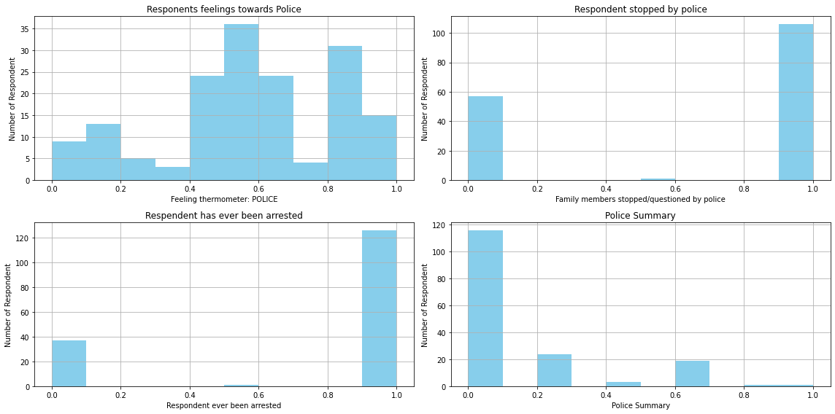
Pilot data - temporal precedence (2016 police attitudes)
Notes:
Show pilot data demonstrating some statistical relationship, including temporal precedence and covariance between your proposed cause and effect. (+2)
Histogram of police attitudes in 2016 and 2020
Correlation matrix between 2016 columns and 2020 columns
Use other factors of vaccine hesitancy to rule out plausible alternative explanations

Slide 45
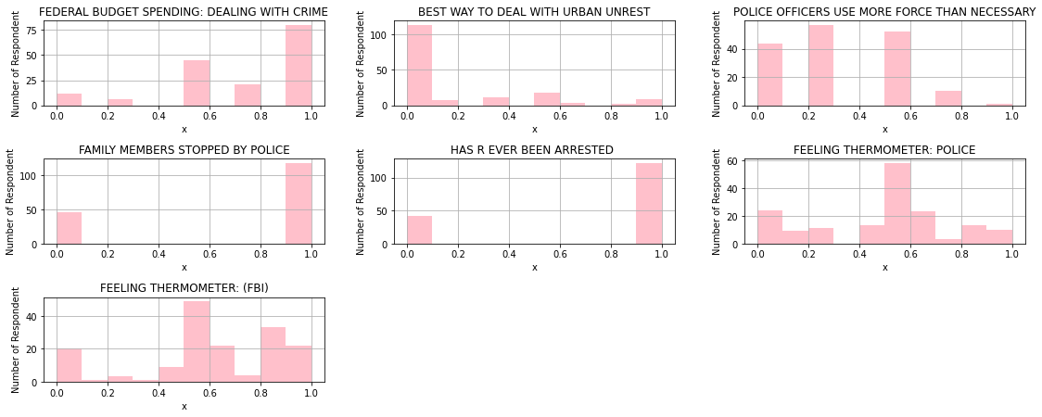
Pilot data - temporal precedence (2020 police attitudes)
Notes:
Show pilot data demonstrating some statistical relationship, including temporal precedence and covariance between your proposed cause and effect. (+2)
Histogram of police attitudes in 2016 and 2020
Correlation matrix between 2016 columns and 2020 columns
Use other factors of vaccine hesitancy to rule out plausible alternative explanations

Slide 46
Notes:
Show pilot data demonstrating some statistical relationship, including temporal precedence and covariance between your proposed cause and effect. (+2)
Arrests per capita histogram
Plot of Black population in ZIP vs. arrests per capita
Correlation matrix for study 3

Slide 47
Possible type of Threats to Internal Validity
History confounds:
COVID-19 pandemic
Black Lives Matter movement
2020 US Presidential election
Maturation confounds
Disease outbreaks become less important over time
New variants of diseases
Testing confounds
Unwillingness to be open about vaccine hesitancy or resentment towards law enforcement
Respondents from ANES 2020 who also took ANES in 2016 may “figure out” motives behind survey
Notes:
What are the threats to the internal validity of your analysis? (+2)
Which of these threats are plausible? (+2)
History confounds:
The pandemic made people scared to go outside -> PLAUSIBLE
The Black Lives Matter movement/2020 election and events leading up to the January 6th Capitol Riot increased awareness of police brutality -> PLAUSIBLE
Maturation confounds:
Diseases like COVID-19 will became less important to the population -> PLAUSIBLE
New variants of diseases that changes attitudes towards getting vaccinated -> PLAUSIBLE
Testing confounds:
People who are more hesitant to vaccinate and more resistant to police may not state that - why our respondent size is more vaccine hesitant -> PLAUSIBLE
People who took the ANES survey in 2016 and 2020 may “figure out” the point of each response and may give superficial answers -> PLAUSIBLE

Slide 48
Possible type of Threats to Internal Validity (cont.)
Instrumentation confounds
Likert scale biases
Statistical regression confounds
Too many respondents are not vaccine hesitant
Small sample size
Effect of police attitudes on vaccine hesitancy may extend beyond systemic racism
Experimental mortality
Some respondents did not answer post-election survey
Notes:
What are the threats to the internal validity of your analysis? (+2)
Which of these threats are plausible? (+2)
Instrumentation confound:
Attitudes towards the police and vaccine rates are on a subjective scale - a Likert value in one person is a different Likert value in another -> PLAUSIBLE
Statistical regression confounds:
Too many respondents are not vaccine hesitant -> PLAUSIBLE
Small sample size - we don’t know the actual mean vaccine hesitancy -> PLAUSIBLE
Police attitudes could be attributed to vaccine hesitancy beyond systemic racism towards Black Americans on a systemic scale -> PLAUSIBLE
Police attitudes could be attributed to vaccine hesitancy beyond systemic racism towards Black Americans on a systemic scale; we do not know other races’ attitudes towards the police-> PLAUSIBLE
Experimental mortality:
Some people did not answer post-election survey which had questions on vaccine hesitancy -> PLAUSIBLE

Slide 49
Possible type of Threats to Internal Validity (cont.)
Multi-group confounds
Transportation in the US is in decline - may have contributed to access issues
Homeless individuals not included in study
Mental health conditions and social influences affected during pandemic
Social threats
Resentful demoralization
Compensatory equalization of treatment
Notes:
What are the threats to the internal validity of your analysis? (+2)
Which of these threats are plausible? (+2)
Multi-group threats:
Access issues and income disparities amongst vaccine hesitant -> PLAUSIBLE
Homeless individuals were not eligible to take part in the ANES survey -> PLAUSIBLE
Mental health conditions and social dynamics were affected throughout the course of the COVID-19 pandemic -> PLAUSIBLE
Social threats:
Resentful demoralization/compensatory equalization of treatment: Respondents may say they have better relations with police when they do not as they may want to; respondents may be triggered by mentions of police due to systemic racism against them > PLAUSIBLE

Slide 50
Notes:
Choose an experimental design to rule out plausible threats, assuming you can manipulate all units of analysis and conduct random assignment. Your design should allow you to rule out all plausible confounds. (+2)
Choose randomized experiment design to assign people to control and treatment - treatment will be assigned to city with police reforms, control will be assigned to city without police reforms
Pretest-posttest control group design - respondents assigned to treatment or control group at random
Treatment will be assigned to city with police reforms, control will be assigned to city without police reforms
Observe vaccine attitudes before they move to city
Observe vaccine attitudes a year after they move to city
All cities have the same infrastructure and public health systems to control for accessibility to vaccines and healthcare, differ in terms of policies related to policing
Observe participants’ media sources, disease rates, perceived risk, political affiliation, attitudes and beliefs about vaccines along with vaccine behaviors
Measure vaccine rates and share of Black population vaccinated in different cities

Slide 51
Notes:
Acknowledging any manipulations that are not feasible, which threats to internal validity are you unable to address? (+2)
Randomized design with assigning people into different areas with unique laws on police accountability may go against ethical guidelines
Constructing two cities for the sake of a study is infeasible
History confounds:
COVID-19 pandemic
Black Lives Matter movement
2020 US Presidential election
Maturation confounds
Disease outbreaks become less important over time
New variants of diseases
Testing confounds
Unwillingness to be open about vaccine hesitancy or resentment towards law enforcement
Respondents from ANES 2020 who also took ANES in 2016 may “figure out” motives behind survey
Instrumentation confounds
Likert scale biases
Statistical regression confounds
Too many respondents are not vaccine hesitant
Small sample size
Effect of police attitudes on vaccine hesitancy may extend beyond systemic racism
Experimental mortality
Some respondents did not answer post-election survey
Multi-group confounds
Transportation in the US is in decline - may have contributed to access issues
Homeless individuals not included in study
Mental health conditions and social influences affected during pandemic
Social threats
Resentful demoralization
Compensatory equalization of treatment

Slide 52
Notes:
Propose a combination of quasi-experimental designs might you use to mitigate the remaining threats to internal validity. Discuss how it would rule out other measure the size of these remaining threats. (+2)
Study 1: ANES 2020 non-equivalent group posttest-only design
Treatment is respondents who have better attitudes towards police, control is respondents who have worse attitudes towards police in 2020
Measure vaccine uptake, and attitudes towards vaccine mandate as outcome variables
Control for historical confounders related to trust in the government, trust in the healthcare system, susceptibility to misinformation, etc.
Study 2: ANES 2016 vs ANES 2020 non-equivalent group pretest and posttest
Treatment is respondents who have better attitudes towards police, control is respondents who have worse attitudes towards police in 2016
Measure vaccine uptake, and attitudes towards vaccine mandate as outcome variables
Control for historical confounders related to trust in the government, trust in the healthcare system, susceptibility to misinformation, etc.
Study 3: NYC arrest vs. vaccines data non-equivalent group pretest and posttest
Treatment is ZIP codes that have higher than average arrests per capita, control is ZIP codes that have lower than average arrests per capita in 2021
Measure accessibility, income, case rate, percent with a college degree, percent Black, vaccine rate

Slide 53
Notes:
Demonstrate your proposed experimental or quasi-experimental design on pilot data. (+2)
Show statistics and histograms of treatment and control groups

Slide 54
Notes:
Is the student’s analysis plan solid? Have they provided initial/pilot results that support this approach? (16 pts)

Slide 55
Variables - Study 1 (ANES 2020)
Independent variables
Feeling thermometer: Federal Bureau of Investigation
Feeling thermometer: Police
Dependent variables
Attitudes towards vaccine mandates
Healthcare and vaccine uptake
Notes:
Describe in detail the independent variables, dependent variables, and the relationship that you expect to find between them in your study. (+2)

Slide 56
Variables - Study 2 (ANES 2016-2020)
Independent variables
Feeling thermometer: police (2016)
Dependent variables
Attitudes towards vaccine mandates (2020)
Notes:
Describe in detail the independent variables, dependent variables, and the relationship that you expect to find between them in your study. (+2)

Slide 57
Study 3 - NYC ZIP-level data
Independent variables
Arrests per capita by ZIP
Dependent variables
COVID-19 fully vaccinated rate by ZIP, October 2021
COVID-19 1+ doses rate ZIP, October 2021
Notes:
Describe in detail the independent variables, dependent variables, and the relationship that you expect to find between them in your study. (+2)

Slide 58
Notes:
What statistical or machine learning analysis do you plan to conduct to determine whether this relationship exists or not? (+2)
ANCOVA on studies 1,2,3 - we transformed the dependent variables into a normal distribution using Boxcox transformation
Data is on Likert Scale for studies 1 and 2, but it is possible to run ANCOVA assuming the limitations that the scale has - it will be difficult to evaluate covariates using nonparametric tests
Data for study 3 is continuous - can run ANCOVA

Slide 59
Notes:
Generate and clean pilot data reflecting each of the variables identified above. Display descriptive statistics of these data, including histograms, measures of central tendency and dispersion. (+2)
For each variable in studies 1,2,3:
Histograms
Mean, median, standard deviation
Chi square test for normality

Slide 60
Notes:
Conduct a preliminary test of the relationships between your variables of interest using a correlational method. Justify your choice of this method given the distribution of the data. (+2)

Slide 61
Type 1 error corrections - Holm Bonferroni
P-values ranked (ANES 2020):
1b | 0.843392
1d | 0.327095
2a | 0.040394
2b | 0.009563
1c | 2.688200e-12
1a | 3.154086e-18
P-values ranked (NYC data):
3a | 3.206325e-04
3b | 3.214382e-02
Notes:
How many analyses do you plan to conduct using your dataset? Choose a Type I error rate using this information. (+2)

Slide 62
Type 1 error corrections - Holm Bonferroni
Adjusted critical p-values (ANES 2016/2020)
1b - 0.99/(6-6+1) | 0.05
1d - 0.05/(6-5+1) | 0.025
2a - 0.05/(6-4+1) | 0.0167
2b - 0.05/(6-3+1) | 0.0125
1c - 0.05/(6-2+1) | 0.01
1a - 0.05/(6-1+1) | 0.00833
Notes:
How many analyses do you plan to conduct using your dataset? Choose a Type I error rate using this information. (+2)

Slide 63
Type 1 error corrections - Holm Bonferroni
Adjusted critical p-values (NYC data):
3b - 0.05/(2-2+1) = 0.05
3a - 0.05/(2-1+1) = 0.025
Notes:
How many analyses do you plan to conduct using your dataset? Choose a Type I error rate using this information. (+2)

Slide 64
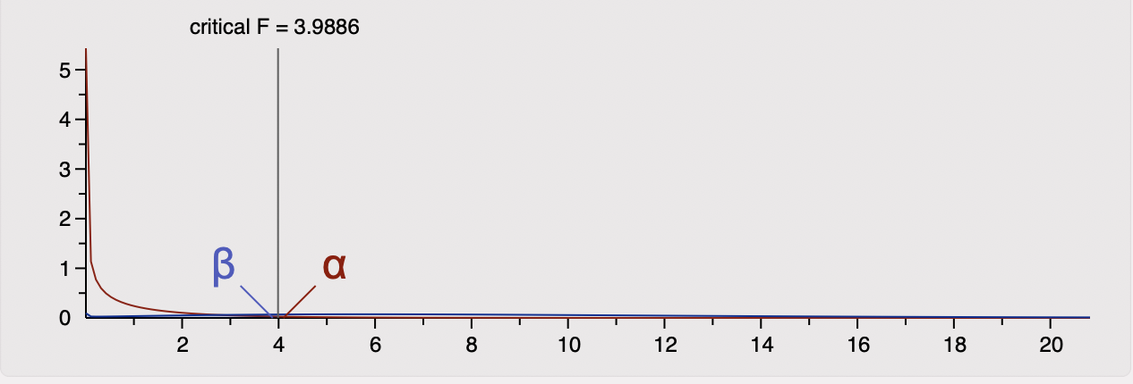
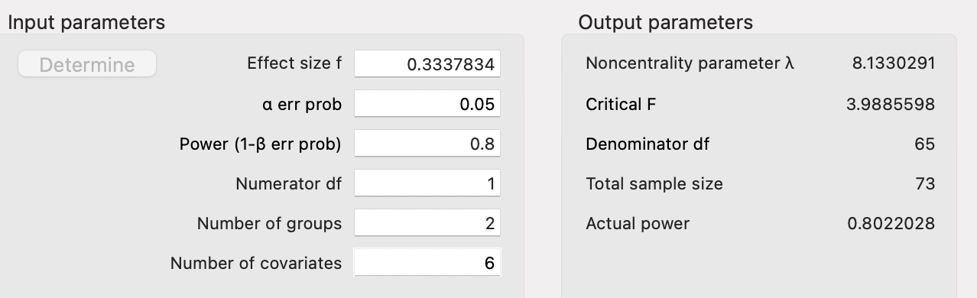
Power analysis - Study 1a
Notes:
Conduct a power analysis to determine how much data are necessary to detect the hypothesized relationship. You may use off-
the-shelf software. Your power analysis should be based on pilot data. (+2)

Slide 65
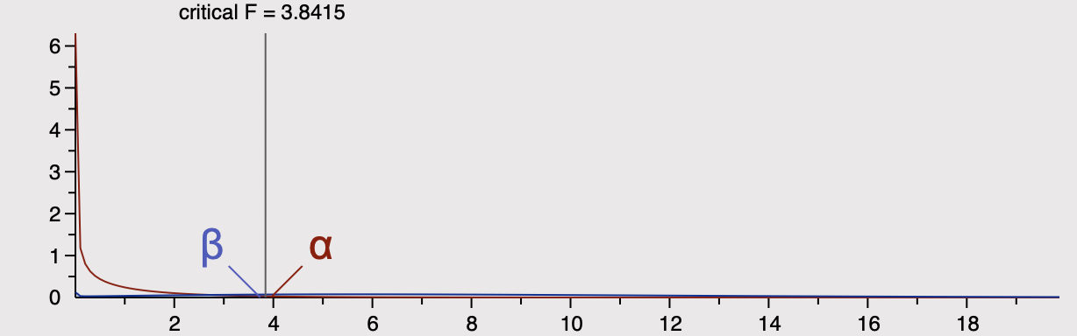
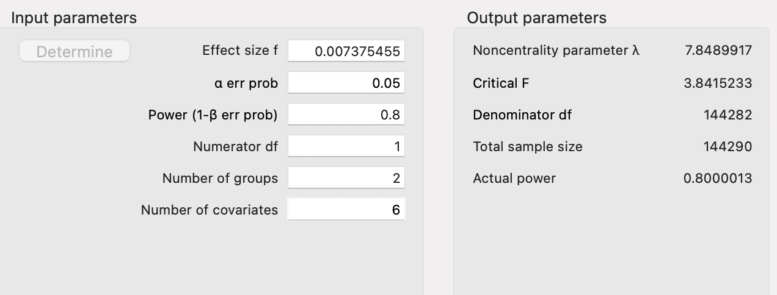
Power analysis - Study 1b
Notes:
Conduct a power analysis to determine how much data are necessary to detect the hypothesized relationship. You may use off-
the-shelf software. Your power analysis should be based on pilot data. (+2)

Slide 66
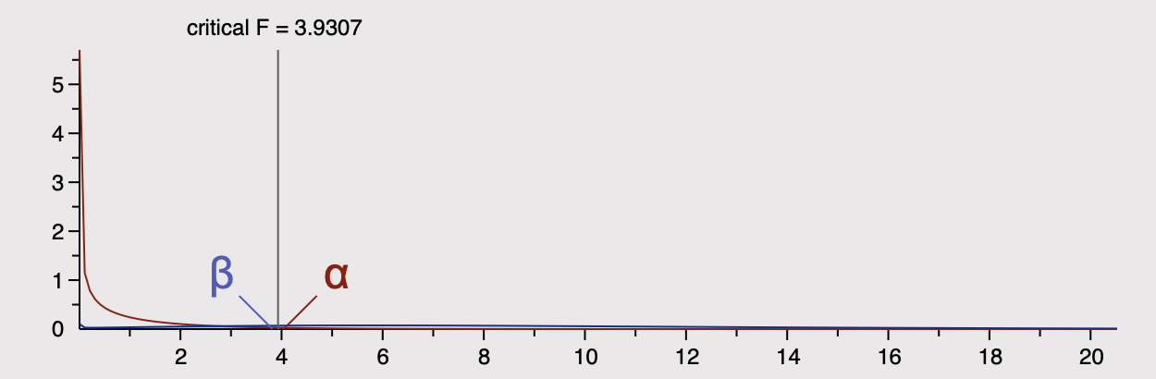
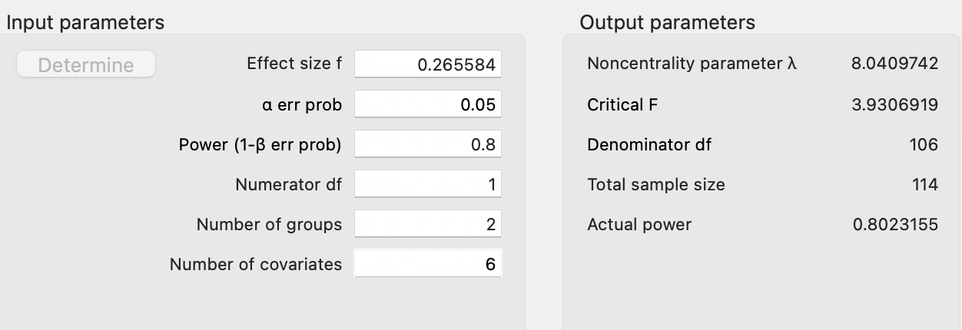
Power analysis - Study 1c
Notes:
Conduct a power analysis to determine how much data are necessary to detect the hypothesized relationship. You may use off-
the-shelf software. Your power analysis should be based on pilot data. (+2)

Slide 67
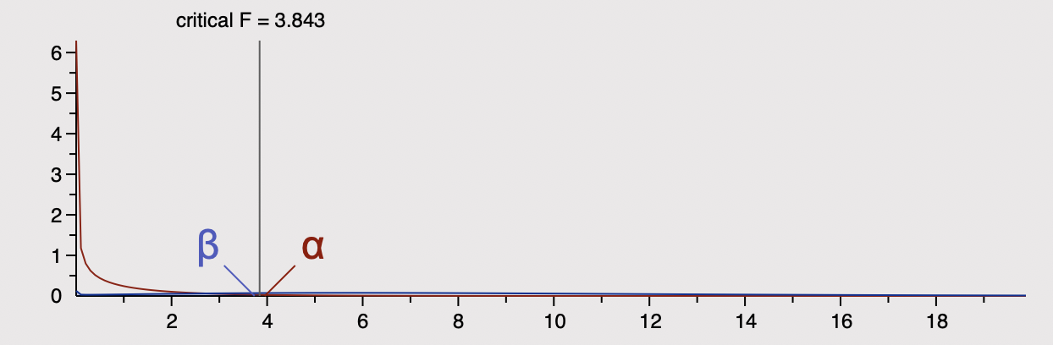
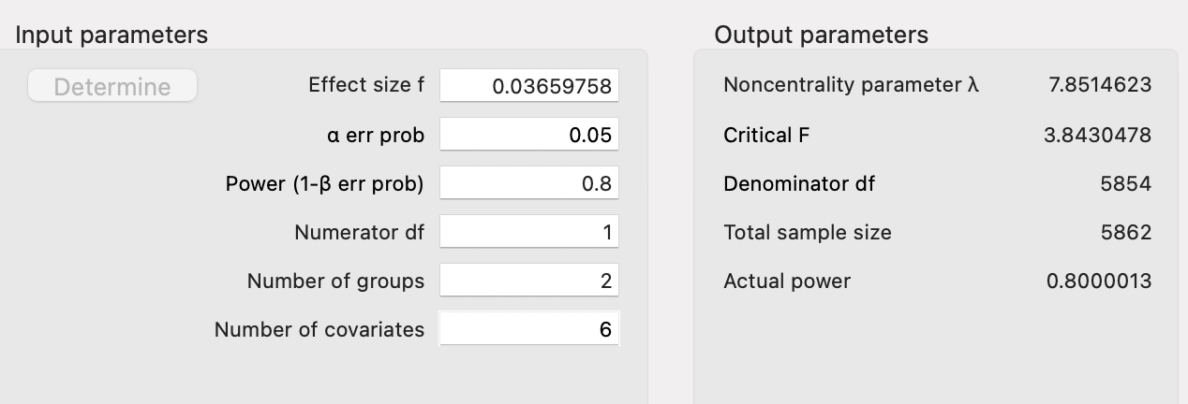
Power analysis - Study 1d
Notes:
Conduct a power analysis to determine how much data are necessary to detect the hypothesized relationship. You may use off-
the-shelf software. Your power analysis should be based on pilot data. (+2)

Slide 68
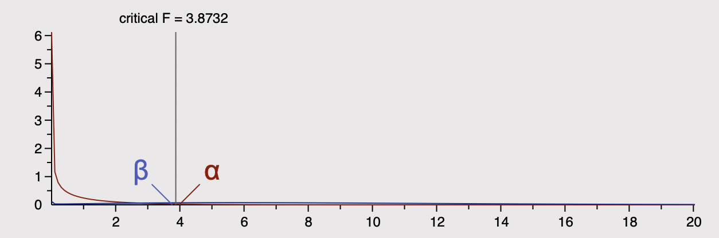
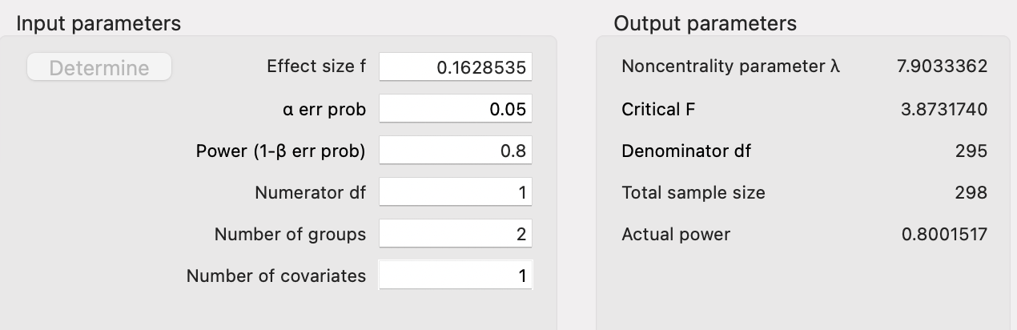
Power analysis - Study 2a
Notes:
Conduct a power analysis to determine how much data are necessary to detect the hypothesized relationship. You may use off-
the-shelf software. Your power analysis should be based on pilot data. (+2)

Slide 69
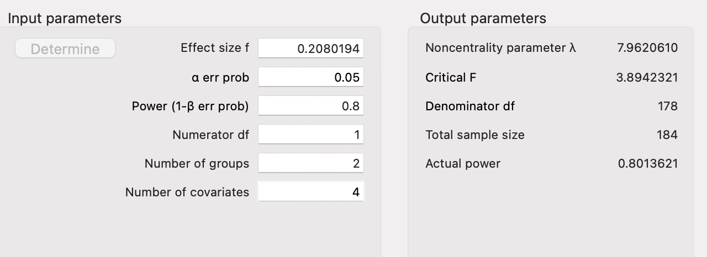
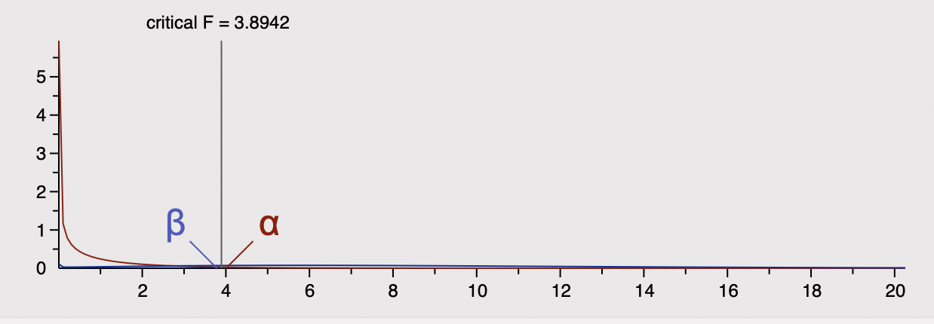
Power analysis - Study 2b
Notes:
Conduct a power analysis to determine how much data are necessary to detect the hypothesized relationship. You may use off-
the-shelf software. Your power analysis should be based on pilot data. (+2)

Slide 70
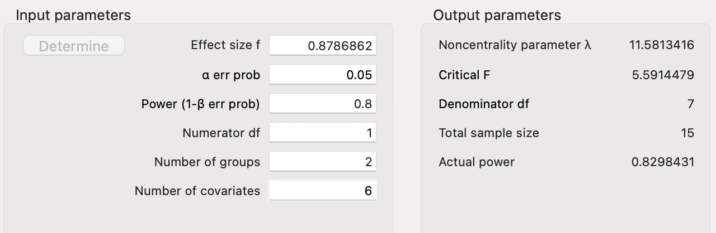
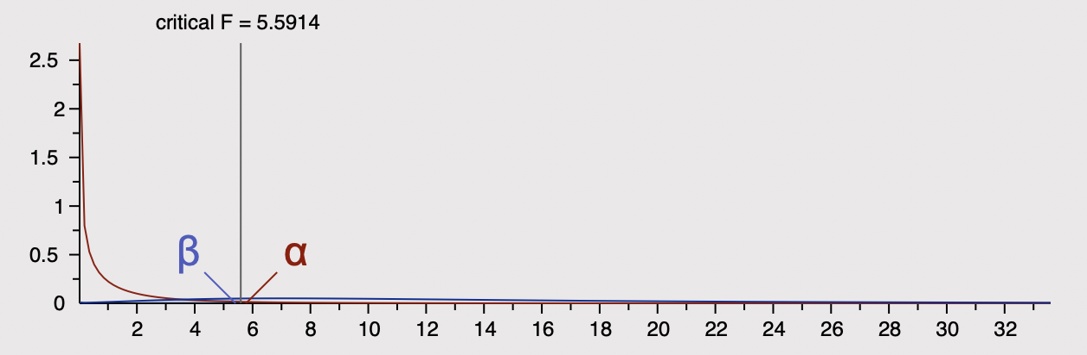
Power analysis - Study 3a
Notes:
Conduct a power analysis to determine how much data are necessary to detect the hypothesized relationship. You may use off-
the-shelf software. Your power analysis should be based on pilot data. (+2)

Slide 71
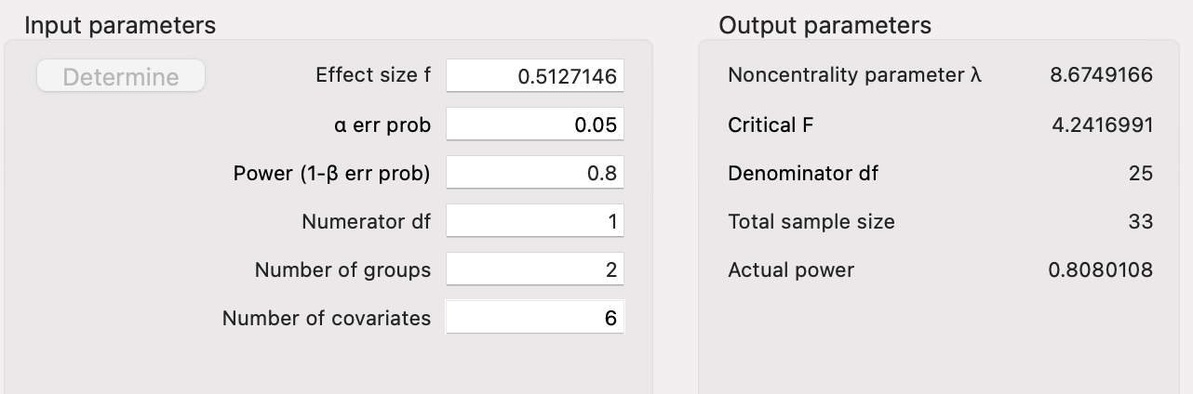
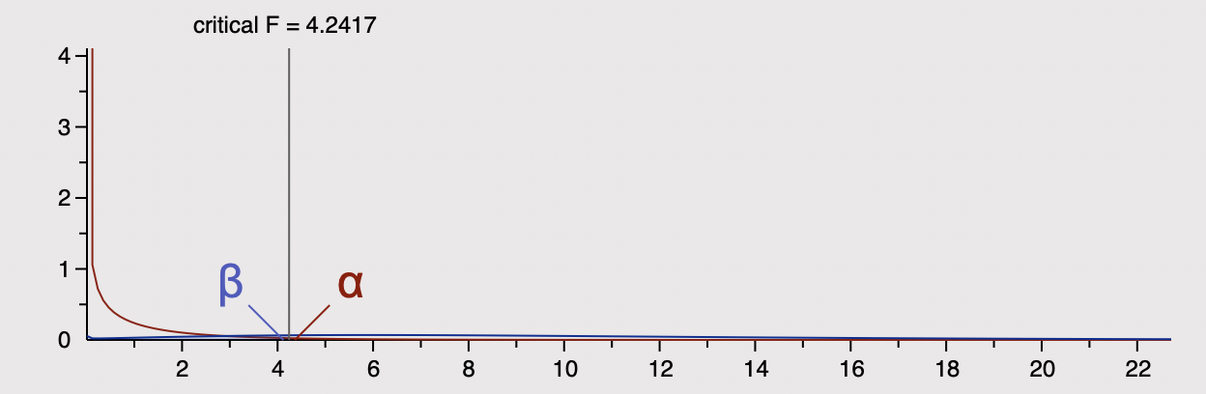
Power analysis - Study 3b
Notes:
Conduct a power analysis to determine how much data are necessary to detect the hypothesized relationship. You may use off-
the-shelf software. Your power analysis should be based on pilot data. (+2)

Slide 72
Analysis
Ancova - out_2:
df sum_sq mean_sq F PR(>F)
group 1.0 55.160810 55.160810 79.993386 3.154086e-18
sus_4 1.0 148.946125 148.946125 215.999457 6.080352e-43
Dis_3 1.0 0.164210 0.164210 0.238135 6.257052e-01
govTrust_8 1.0 0.199144 0.199144 0.288796 5.911596e-01
pol_2 1.0 22.337146 22.337146 32.392996 1.835183e-08
govTrust_5 1.0 0.296622 0.296622 0.430156 5.121223e-01
Hcare_2 1.0 3.786746 3.786746 5.491482 1.938127e-02
Residual 718.0 495.109198 0.689567
Analysis - Study 1a
Treatment: law_7
Ancova - out_1:
df sum_sq mean_sq F PR(>F)
group 1.0 0.039167 0.039167 0.039057 0.843392
sus_4 1.0 0.129952 0.129952 0.129588 0.718965
Dis_3 1.0 0.012349 0.012349 0.012314 0.911672
govTrust_8 1.0 2.860694 2.860694 2.852681 0.091656
pol_2 1.0 0.931189 0.931189 0.928580 0.335557
govTrust_5 1.0 1.790713 1.790713 1.785697 0.181875
Hcare_2 1.0 0.219068 0.219068 0.218455 0.640362
Residual 718.0 720.016868 1.002809
Analysis - Study 1b
Treatment: law_7
Notes:
Conduct your intended analysis using your pilot data. Specify and control for any covariates that you have identified. What does your analysis indicate regarding the hypothesized relationship in the data? (+2)

Slide 73
Covariates
STUDY 2
Trust in government 2016 and 2020 - based on previous literature
STUDY 3
Commute time by ZIP - may influence accessibility to vaccine clinics
Income by ZIP - may influence cost burden of vaccines
Education level by ZIP - may influence attitudes and beliefs about vaccines
Black population percentage by ZIP - control for other variates
STUDY 1
Trust in government - law enforcement influenced by government policies
Trust in the healthcare system - study involves vaccine intake and related healthcare beliefs
Perceived discrimination - based on previous literature
Political affiliation - policies of healthcare & governance vary with different political parties
Notes:
What covariates, if any, do you plan to include in your analysis? Justify your selection of these. (+2)

Slide 74
Analysis
Ancova - out_2:
df sum_sq mean_sq F PR(>F)
group 1.0 34.974297 34.974297 50.644047 2.688200e-12
sus_4 1.0 164.932045 164.932045 238.827565 1.006216e-46
Dis_3 1.0 0.180948 0.180948 0.262019 6.088941e-01
govTrust_8 1.0 0.143529 0.143529 0.207835 6.486072e-01
pol_2 1.0 26.132598 26.132598 37.840947 1.274504e-09
govTrust_5 1.0 0.497263 0.497263 0.720055 3.964087e-01
Hcare_2 1.0 3.295350 3.295350 4.771786 2.925253e-02
Residual 718.0 495.843970 0.690590
Analysis - Study 1c
Treatment: law_6
Ancova - out_1:
df sum_sq mean_sq F PR(>F)
group 1.0 0.962746 0.962746 0.961677 0.327095
sus_4 1.0 0.062628 0.062628 0.062559 0.802568
Dis_3 1.0 0.035387 0.035387 0.035348 0.850922
govTrust_8 1.0 2.636957 2.636957 2.634029 0.105035
pol_2 1.0 0.761760 0.761760 0.760914 0.383334
govTrust_5 1.0 1.992136 1.992136 1.989925 0.158782
Hcare_2 1.0 0.750351 0.750351 0.749518 0.386918
Residual 718.0 718.798034 1.001111
Analysis - Study 1d
Treatment: law_6
Notes:
Conduct your intended analysis using your pilot data. Specify and control for any covariates that you have identified. What does your analysis indicate regarding the hypothesized relationship in the data? (+2)

Slide 75
Analysis
Ancova - out_2020_2:
df sum_sq mean_sq F PR(>F)
group 1.0 4.236949 4.236949 4.269921 0.040394
govt_trust_diff 1.0 0.006280 0.006280 0.006329 0.936689
Residual 161.0 159.756771 0.992278
Analysis - Study 2a
Treatment: law_diff
Ancova - out_2020_2:
df sum_sq mean_sq F PR(>F)
group 1.0 6.796012 6.796012 8.576842 3.908435e-03
govt_trust_2020_8 1.0 0.107273 0.107273 0.135383 7.134071e-01
govt_trust_2016_2 1.0 0.039020 0.039020 0.049245 8.246690e-01
law_2020_2 1.0 0.004637 0.004637 0.005852 9.391205e-01
out_2016_1 1.0 31.858976 31.858976 40.207317 2.289286e-09
Residual 158.0 125.194083 0.792368
Analysis - Study 2b
Treatment: law_2016
Notes:
Conduct your intended analysis using your pilot data. Specify and control for any covariates that you have identified. What does your analysis indicate regarding the hypothesized relationship in the data? (+2)

Slide 76
Analysis
ANCOVA - pct_1plus_post
df sum_sq mean_sq F PR(>F)
group 1.0 12.640267 12.640267 44.688973 3.177476e-10
avg_commute_time 1.0 40.435740 40.435740 142.958345 2.661124e-24
pct_college 1.0 2.239328 2.239328 7.917022 5.474681e-03
income 1.0 1.268343 1.268343 4.484159 3.566464e-02
pop_pct_black 1.0 5.162786 5.162786 18.252747 3.213259e-05
pct_1plus_pre 1.0 67.169070 67.169070 237.472570 4.278841e-34
Residual 170.0 48.084466 0.282850
Analysis - Study 3b
Treatment: arrests_per_capita
ANCOVA - pct_fully_vaccinated_post
df sum_sq mean_sq F PR(>F)
group 1.0 16.235024 16.235024 130.483114 9.278910e-23
avg_commute_time 1.0 43.981609 43.981609 353.486223 2.819043e-43
pct_college 1.0 5.757894 5.757894 46.276985 1.700079e-10
income 1.0 1.605555 1.605555 12.904066 4.296485e-04
pop_pct_black 1.0 9.966903 9.966903 80.105366 6.174005e-16
pct_fully_vacc_pre 1.0 67.524998 67.524998 542.707675 1.208849e-54
arrests_per_capita 1.0 10.900629 10.900629 87.609854 4.883991e-17
Residual 169.0 21.027388 0.124422
Analysis - Study 3a
Treatment: arrests_per_capita
Notes:
Conduct your intended analysis using your pilot data. Specify and control for any covariates that you have identified. What does your analysis indicate regarding the hypothesized relationship in the data? (+2)

Slide 77
09
Summary
Notes:
Provide an overall summary of your plan thus far: question, sampling strategy, measurement strategy, design, and analysis plan. Indicate what you expect to find in the analysis, what the design allows you to say given these findings, what the implications are for your theory, how far you can generalize, and to what extent this answers your question.

Slide 78
What can be addressed:
Police attitudes are associated with with vaccine hesitancy amongst Black Americans, but it is associated with other factors such as trust in the government and socioeconomic factors.
Police attitudes in 2020 are associated with a greater mistrust of the government amongst Black Americans - which is supported by the association between police attitudes in 2020 and support for vaccine mandates.
What we cannot be addressed:
Police attitudes CAUSE vaccine hesitancy when controlled for trust in the government, susceptibility to misinformation
Our findings can generalize to many Black Americans
The relationship between police attitudes and vaccine hesitancy is grounded in history.
Notes:
Provide an overall summary of your plan thus far: question, sampling strategy, measurement strategy, design, and analysis plan. Indicate what you expect to find in the analysis, what the design allows you to say given these findings, what the implications are for your theory, how far you can generalize, and to what extent this answers your question.

Slide 79
Summary - Conclusion Validity
Findings
Limitations
Effect of 2020 police attitudes towards attitudes on vaccine mandates when controlling for confounders.
Statistically significant impact of 2016 police attitudes on vaccine uptake when controlling for government trust.
Statistically significant effect on arrest rates and vaccine uptake in a given area when controlled for confounders
Study 3 was not repeated in multiple cities.
Many variables do not contribute much to the variance of the dependent variables as per our factor analysis- they will need to be studied separately.
Power analysis shows that a larger sample size is required to obtain a
Notes:
Provide an overall summary of your plan thus far: question, sampling strategy, measurement strategy, design, and analysis plan. Indicate what you expect to find in the analysis, what the design allows you to say given these findings, what the implications are for your theory, how far you can generalize, and to what extent this answers your question.

Slide 80
Summary - Internal Validity
Findings
Limitations
Effect of 2020 police attitudes towards attitudes on vaccine mandates when controlling for confounders.
Historical confounders: BLM movement, delta variant of COVID
No data from previous decades hinders our ability to separate our historical confounders.
Possibility of distance to vaccination clinic confounding our results in Study 3 - we could not measure this.
Notes:
Provide an overall summary of your plan thus far: question, sampling strategy, measurement strategy, design, and analysis plan. Indicate what you expect to find in the analysis, what the design allows you to say given these findings, what the implications are for your theory, how far you can generalize, and to what extent this answers your question.

Slide 81
Summary - Construct Validity
Findings
Limitations
Measures of police attitudes correlated with each other, uncorrelated with government trust
Measures of police attitudes correlated with covariates
Study 3 was not repeated with other cities
Notes:
Provide an overall summary of your plan thus far: question, sampling strategy, measurement strategy, design, and analysis plan. Indicate what you expect to find in the analysis, what the design allows you to say given these findings, what the implications are for your theory, how far you can generalize, and to what extent this answers your question.

Slide 82
Summary - External Validity
Findings
Limitations
ANES data can generalize to US population
NYC data provides us a sample of the implications of attitudes towards law enforcement on vaccine hesitancy in urban environments
Cannot extend to homeless population: data does not indicate this.
NYC study is limited to one municipality
726 respondents is likely not indicative of the various subgroups in our theoretical population
Notes:
Provide an overall summary of your plan thus far: question, sampling strategy, measurement strategy, design, and analysis plan. Indicate what you expect to find in the analysis, what the design allows you to say given these findings, what the implications are for your theory, how far you can generalize, and to what extent this answers your question.

Slide 83
Next steps
Expand the sample in Study 3 to other cities.
Use Box-Cox transformation on Studies 1 and 2 to make data normally distributed
Study variables beyond the factor analysis separately.
Study the relationship between police attitudes and trust in the government amongst Black Americans, and its implications on vaccine hesitancy.
Study the relationship between police attitudes and accessibility across neighborhoods and its implications on vaccine uptake.
Look to find larger samples with normally-distributed variables.
Rule out the factor of distance and ease of access to vaccine clinics.
Identify confounding factors from public health experts
Notes:
Provide an overall summary of your plan thus far: question, sampling strategy, measurement strategy, design, and analysis plan. Indicate what you expect to find in the analysis, what the design allows you to say given these findings, what the implications are for your theory, how far you can generalize, and to what extent this answers your question.

Slide 84
Notes:
Has the student communicated their proposal clearly and effectively? What are the implications for policy or decisions if the analysis works? What if it fails? (15 pts)

Slide 85
Notes:
Is the proposal in the appropriate format? (+3)

Slide 86
Notes:
Does the proposal communicate a bottom-line meaning (+3)

Slide 87
Notes:
Does the proposal discuss the implications of success or failure? (+3)

Slide 88
Notes:
Does the proposal go beyond the analysis details to discuss implications for decision-makers? (+3)

Slide 89
Notes:
Does the proposal detail how the question will be answered? (+3)

Slide 90
Notes:
Other considerations? (9 pts):

Slide 91
05
References

Slide 92
References
Bajaj, Simar Singh, and Fatima Cody Stanford. “Beyond Tuskegee - Vaccine Distrust and Everyday Racism.” The New England journal of medicine vol. 384,5 (2021)., https://doi.org/10.1056/NEJMpv2035827
Jennifer Tolbert, Kendal Orgera. “Vaccination Is Local: Covid-19 Vaccination Rates Vary by County and Key Characteristics.” Kaiser Family Foundation, Kaiser Family Foundation, 12 May 2021
Bogart, Laura M., Lu Dong, Priya Gandhi, Samantha Ryan, Terry L. Smith, David J.Klein, Luckie-Alexander Fuller, and Bisola O. Ojikutu, What Contributes to COVID-19 Vaccine Hesitancy in African Communities, and How Can It Be Addressed?. Santa Monica,CA:RAND Corporation, 2021 https://www.rand.org/pubs/research_reports/RRA1110-1.html
Dunbar, Adam, and Nicole E. Jones. “Race, Police, and the Pandemic: Considering the Role of Race in Public Health Policing.” Ethnic and Racial Studies, vol. 44, no. 5, 2020, pp. 773–782., https://doi.org/10.1080/01419870.2020.1851381.
Bunch, Lauren. “A Tale of Two Crises: Addressing Covid-19 Vaccine Hesitancy as Promoting Racial Justice.HEC forum:an interdisciplinary journal on hospitals’ ethical and legal issues vol. 33,1-2 (2021): 143-154.doi:10.1007/s10730-021-9440-0

Slide 93
References
6. Fox, Maggie. “Unvaccinated People Are 'Variant Factories,' Infectious Diseases Expert Says.” CNN, Cable News Network, 4 July 2021.
7.Quinn, Sandra Crouse, et al. “Breaking down the Monolith: Understanding Flu Vaccine Uptake among African Americans.” SSM - Population Health, vol. 4, 11 Nov. 2017, pp. 25–36., https://doi.org/10.1016/j.ssmph.2017.11.003.
8. Rosenthal, A., Motta, M., & Farhart, C. E. (2021, July 5). Beyond Tuskegee, To Middlesboro: How Perspectives of Policing Shape Vaccine Attitudes for African Americans.https://doi.org/10.31235/osf.io/wjq4a
9. Warren, Rueben C et al. “Trustworthiness before Trust - Covid-19 Vaccine Trials and the African Community.” The New England journal of medicine vol. 383,22 (2020): e121.doi:10.1056/NEJMp2030033 Warren,Reuben C
10. Zainab Toteh Osakwe, Jennel C. Osborne, Nonso Osakwe, Ana Stefancic, Facilitators of COVID-19 vaccine acceptance among African and Hispanic individuals in New York: A qualitative study, American Journal of Infection Control,Volume 50,Issue 3, 2022, Pages 268-272, ISSN 0196-6553,https://doi.org/10.1016/j.ajic.2021.11.004.
.

Slide 94
Thank You!
Any Questions?

